Slide 1

EUROPEAN SOCIAL INNOVATION
WEEK
Tilburg, September 15, 2014
The state of Social Innovation in Europe:
On the move to permeate into existing innovation systems
Josef Hochgerner
Zentrum für Soziale Innovation

Slide 2


Overview
Innovation culture in the industrial society: The prevailing paradigm of innovation and innovation systems
Extending the paradigm by introducing the concept of social innovation: Definition and the 4-i process
Permeation of social innovation in the knowledge society: Ideas, organisations and emerging infrastructures
Trends and examples of measures and support on European and national levels

Slide 3
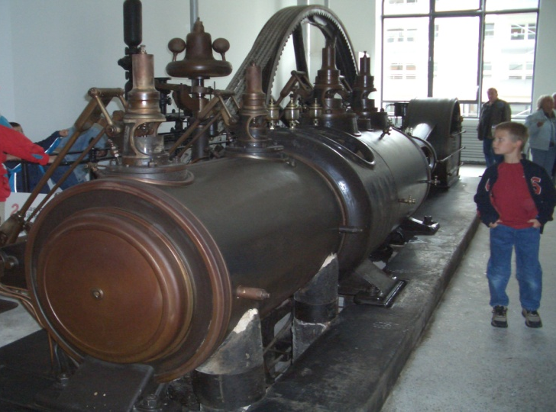
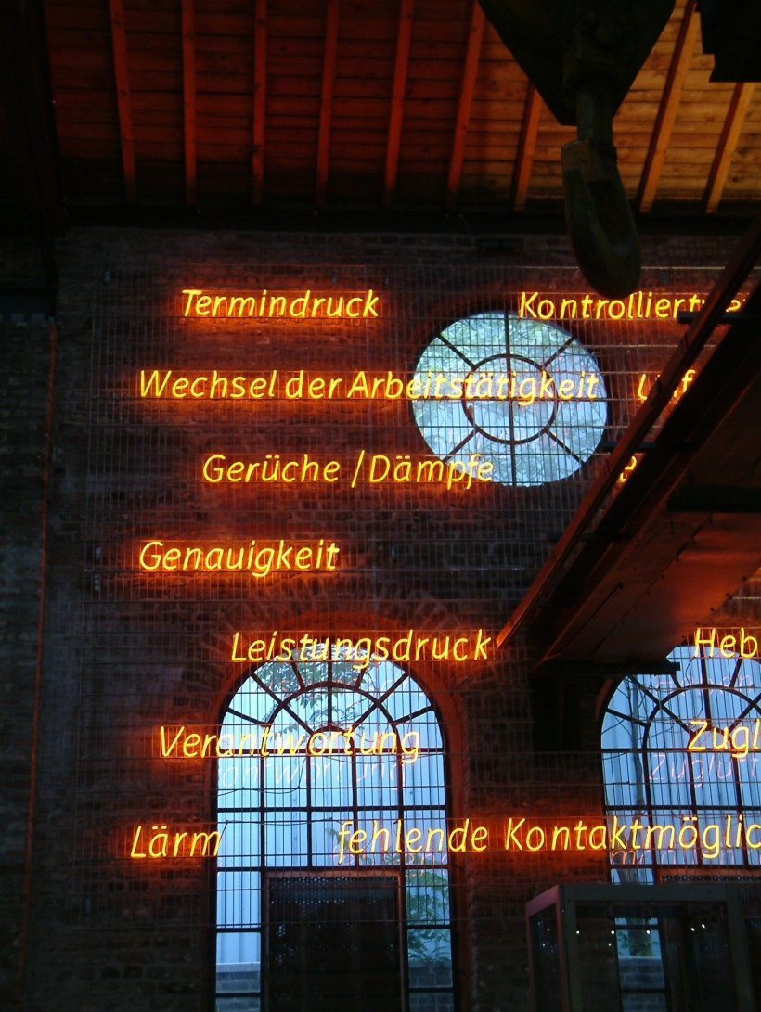

Innovations are embedded in social change
„Brave New World“:
Optimisation of human bevaiour in social systems – 20th century
The most famous steam engine -
Optimised by James watt, 1776
Standardisation
Weak ties in social relations: Flexibility
Acceleration, ‘speed kills‘
Pressures
Work-load
„Humans by Design“:
Optimisation in the 21st c.?
„Work-Life Balance“
1. Innovation culture …

Slide 4
„ALL INNOVATIONS ARE SOCIALLY RELEVANT“
Innovations, including social innovations, are part of social change, based on culture & frames of reference
Cultural patterns, frames of reference and dynamics of social change
Innovations intending economic value added: products, processes, marketing, organisational change in business
Innovations intending social impact:
roles, relations, norms, values
in all sectors of society
1. Innovation culture …
Social change: „The procedural transformation of the structure and basic institutions of society, its cultural patterns, associated social acts, behaviour and consciousness“; my shortened translation from Zapf, W., 2003: Sozialer Wandel, in: Schäfers, B. (ed.): Grundbegriffe der Soziologie, Opladen, 427-433.

Slide 5


Society generates innovation
Innovations expand the range of human action ...
... and facilitate sometimes spectacular achievements:
The culture of innovation favours
engineered changes no matter of societal „sediments“:
Technology made ‚skin‘ of society
The power structures in society
Modes of communication in society, between individuals, organisations, organisms and artifacts
Frames of reference, shaping manners, mores, myths & rites
The balance or imbalance of emotions in society (security / insecurity, hope / fear,
empathy / hatred … )
Earth rise from moon orbit, December 24, 1968
„Sputnik shock“ in the U.S. → and the vision thereafter
A walk in the sunshine,
July 21, 1969
Social innovations required at all levels
Not one big innovation,
nor a series of innovations only!
→ result of a powerful socio-technical system,
enabled by a particular culture of innovation

Slide 6
100 years of innovation theory and current innovation research
Comparison of the ‘new combinations’ according to Schumpeter with the ‘main types of innovations’ according to the Oslo Manual |  | … and the main types of social innovations
New combinations of production factors # (SCHUMPETER 1911) | Innovations in the corporate sector (OECD/EUROSTAT 2005, ‘Oslo Manual’) | New combinations of social practices: social innovations, established in the form of …
New or better products | Product innovations | Roles
New production methods | Process innovation | Relations
Opening up new markets | Marketing | Norms
Reorganization of the market position | Organizational innovations | Values
New sources of raw materials
1. Innovation culture …
Recommended Video „Schumpeter adopts social innovation“ → http://www.socialinnovation2011.eu (9 min.)

Slide 7
The classic and dominant business concept of innovation
„Innovation“ is the successful implementation of a new product or process (including organisational, marketing or service novelties) into a market: „Commercialisation“ and diffusion.
<Thumb-rules> to assess the fundamental economics of innovation:
From ideas to innovation:
(a) The probability of success
⇨ 100 Research ideas
  ⇨ ⇨ 10 Trials / prototypes
    ⇨ ⇨ ⇨ ⇨ ⇨ 1 Innovation
From ideas to innovation:
(b) The costs of success
⇨ ⇨ ⇨ 100 € to market implementation
⇨ ⇨ 10 € for technology development
⇨ 1 € spent for research
1. Innovation culture …

Slide 8

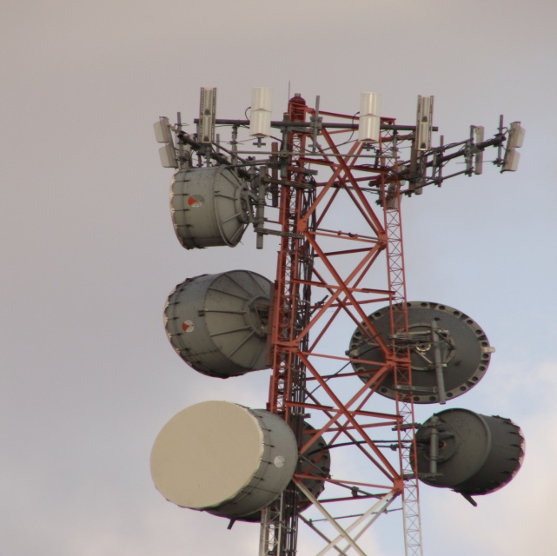

Social change, development, crisis and ‚Grand Challenges‘:
Resources and solutions
WHY SOCIAL INNOVATION ?
Evolution
of Brains
Innovative
Technologies
1. Innovation culture …
Social Innovation for Social Action !
Collaborative intelligence & intelligent collaboration
>> Cultural Evolution

Slide 9
The first world-wide conference on social innovation
research with 370 participants from 54 countries
around the globe. * Vienna, 19-21 Sep. 2011
“The tracks of international research on innovation demonstrate that the technology-oriented paradigm – shaped by the industrial society – does not cover the broad range of innovations indispensable in the transition from an industrial to a knowledge and services-based society: Such fundamental societal changes require the inclusion of social innovations in a paradigm shift of the innovation system.”
Cf. the “Vienna Declaration: The most relevant topics in social innovation research”, 2011, adopted by the conference CSI.
Information online: www.socialinnovation2011.eu
2. Extending the paradigm …

Slide 10
“THE GREAT TRANSFORMATION”
Karl Polanyi, 1944:
Economic processes separate from society, dominate
social relations instead of being regulated to benefit societal needs
Stress in social systems
Economy
Society
Society becomes an
annex to the economy
and „market forces“
Will there be social innovations to
integrate economy in society?
Humankind (the ‚Knowledge Society‘) owns affluent knowledge & other resources.
However, too little of existing capacities is used in current practises.
2. Extending the paradigm …
Society
Environ-
ment
Economy

Slide 11
The termination of the ‚golden age of capitalism‘ *)
Wages remain static whilst productivity increases, USA 1959-2005
Stress in social systems
Index of productivity
1959 until 2005 (USA)
(1959=100)
Index of hourly compensation
of production workers and
non-supervisory workers
2. Extending the paradigm …
U.S. Data,
Source:
Economic Policy Institute
*) Eric Hobsbawm

Slide 12
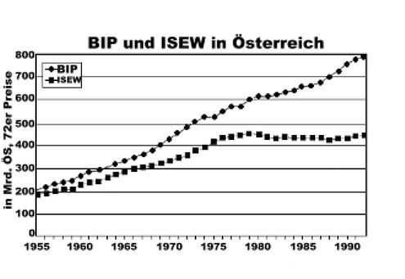
The termination of the ‚golden age of capitalism‘
Wealthier society provides less additional welfare
GDP (‚BIP‘) compared to ISEW (Index of Sustainable Economic Welfare)
in Austria, 1955 – 1992
Stress in social systems
2. Extending the paradigm …
Source: Stockhammer et al. 1995

Slide 13
The social dimensions of innovation
Innovations are ‚changes or novelties of rites, techniques, customs, manners and mores.‘
Horace Kallen, 1949: Innovation, in: Encyklopedia of the Social Sciences; Vol. 8; pp. 58ff.
****
‘Innovation is not just an economic mechanism or a technical process. It is above all a social phenomenon.
Through it, individuals and societies express their creativity, needs and desires.
By its purpose, its effects or its methods, innovation is thus intimately involved in the social conditions in which it is produced.’
European Commission, 1995: Green Paper on Innovation
http://europa.eu/documents/comm/green_papers/pdf/com95_688_en.pdf
2. Extending the paradigm …

Slide 14
An analytical definition of „Social Innovation“ *)
The CONCEPT OF SOCIAL INNOVATION
Distinction between idea and implementation: an idea becomes an innovation
in the process of its factual realization – it changes social action & practices
»Social innovations are new practices
for resolving societal challenges,
which are adopted and utilized by the individuals, social groups and organizations concerned.«
With reference to Schumpeter
(‚Innovations are new combinations of production factors‘)
→ »Social innovations are new
combinations of practices«
2. Extending the paradigm …
*) Zentrum für Soziale Innovation, 2012:
„All innovations are socially relevant“
ZSI-Discussion Paper 13, p. 2: www.zsi.at/dp

Slide 15
HOW TO CREATE SOCIAL INNOVATION ?
The „4-i process“ of social innovation development:
  Idea >> What is the issue, what could be the solution?
  Intervention >> Conceptualisation, define approaches, methods
  Implementation >> Using resources, breaking deadlocks, cooperation
  Impact >> Measures of quality, range and scales, life cycle!
Ideation
Intervention
Implementation
Impact
2. Extending the paradigm …
Only if there is notable impact, according to the objective(s), besides, or even without an initial certain intention, an idea becomes an innovation.
Success criteria: Novelty or superiority of the solution; benefit to the target group(s); sustainability; replicabilty and scaling (not feasible in any case).

Slide 16
HOW TO IDENTIFY SOCIAL INNOVATIONS ?
Evaluation criteria, applied by „SozialMarie“ – Award for Social Innovation in Austria and neighbouring countries:
  Idea >> Novelty in absolute terms or in new environs
  Intervention >> Involvement of the target group(s)
  Implementation >> Effectiveness after acceptance
  Impact >> Replicability (potential to serve as a model)
2. Extending the paradigm …
Main types of social innovations = New practices, combined in patterns of either totally new or modified roles, relations, norms, values.
Comparable to the main types products, processes, marketing and organisational innovations; re. Oslo Manual, OECD 2005; http://epp.eurostat.ec.europa.eu/cache/ITY_PUBLIC/OSLO/EN/OSLO-EN.PDF

Slide 17
Areas relevant to social change | Examples of social innovations
 | Old / historic / previous | New / current / future
Science, education and training Work, employment and the economy Technologies, machinery Democracy, politics and justice Social and health care systems | Universities; compulsory education; Kindergarden; pedagog. concepts e.g. Montessori ... Trade unions; Chambers of commerce/labour; Taylorism; Fordism; self service Norms and standardisation; mechanisation of house keeping; traffic rules; drivers licence ‘Attic democracy’; the state as a juristic person; general elections Social security; retirement schemes, welfare state | Technology enhanced learning; ‘micro-learning’, Web 2.0; Wikipedia; ‘science mode 2’ Flextime wage records; CSR; social entrepreneurship; diversity mgmt.; collaborative consumption Open source movement (com-munities); self constructed solar panels; decentralized energy prod. Citizens participation; 3rd sector; equal rights; gender mainstreaming Reforms of financing and access to welfare (e.g. ‘birth right portfolio’)
2. Extending the paradigm …

Slide 18
Analysing social innovations examples
Public sector: Municipality of Kapfenberg (AT) – „Future for all“
  Idea >> Issue poverty – social assistance without stigmatisation
  Intervention >> „Activity Card“
  Implementation >> Transport, Caritas, Supermarket, Cafe, Sports ...
  Impact >> Participation, elevating quality of life and cohesion
Business sector: ERSTE Bank (AT) – „2nd Savings Bank“
  Idea >> Issue private persons excluded from finacial services, re-inclusion
  Intervention >> Collaboration with insolvency advisers and social care NGO
  Implementation >> Access to bank account, guidance by the NGO and bank volunteers
  Impact >> Learning, inclusions, empowerment, scaling
Civil society: Nagykaniza (HU) – „Social housing reconstruction camp“
  Idea >> Issue: social exclusion, threat of eviction from homes
  Intervention >> Negotiating rent arrears compensation by labour contributed
  Implementation >> Contracts, camp and co-ordination of students, roma, professionals
  Impact >> Better houses, cost/energy reduction, empowerment, replication
2. Extending the paradigm …

Slide 19
The passage from the past
Institutional / policy support on EU & national levels
Infrastructure
emerges from:
Organisations
Concepts
Support
Organisations in science and praxis
UN Off. of Partnerships:
Global Summit-2012
Research: FP7
EC, 2011 ► Horizon 2020
SINNERGIAK
Asian SI Award
Hong Kong 2011
ESSI
>Social Innovation Europe<
EC, 2011
Office of Social Innovation
White House 2009
SozialMarie, AT
Award f SI - 2005
National policies and strategy
RTDI-Programmes 2010 ff
UN: CEPAL: Award
f Soc. Exp. , 2004
... more CSI‘s:2004 onwards
e.g. Canada, NL, AUS, NZ, COL ...
Flagship Innovation Union
EC, 2010
Center for Social Innovation
Stanford U., 2000
BEPA Report
EC, 2010
Theoretical precursors & ideas
Social Innovation Ltd.
Dortmund, 1994
12 book titles
re. Social innovation
1944-1994
Business Panel: Future
of Innov. EC, 2009
Centre for Social Innovation
Vienna, 1990
European Social Agenda
EC, 2008
Stuart Conger, 1974
‚Social Invention‘
‚CRISES‘, Canada
U. Of Quebec, 1988
3. Permeation …
Horace Kallen, 1932
Institute of Social Invention
London, 1985
William Ogburn, 1922
‚Cultural lag‘
Schumpeter, 1911
Social thought in the 19th c.

Slide 20
BUILDING SOCIAL INNOVATION INFRASTRUCTURES
Towards a social innovation system for research, education and training ― key requirements and existing examples:
Incorporation of SI in universities, vocational training and adult education facilities → good examples Tilburg U., Danube U.
(Academic) Education and (vocational/professional) training to establish a professional profile of social innovators → M.A. in Social Innovation
Innovation in science (working in a research-education-services triangle) → ‘Science Mode 2’ (Nowotny et al.), Citizen Science; ZSI “research-application sl.”
Funding institutions → new PPP, Foundations, crowd funding, …
Measures supporting individual social innovators at policy levels from local to international → setting up and developing SI incubators
Research organizations, research programmes, research projects → H2020 …
Indicators and measurement of social innovation → still weak, MERIT, SROI …
Public relations and communication (magazines, networks, various media) → Platforms like SIX, SIE, ESSI
Clarification of legal aspects between open source and IPR → utilisation and impact of SI, methodology handbooks and guides etc.
Anchors exist and may further develop within national systems of innovation. Beyond these, national and international SI-institutions become necessary as intermediaries between civil society, the state and the business sector.
3. Permeation …

Slide 21

3. Permeation …

Slide 22
THE CASE OF ZSI – ZENTRUM FÜR SOZIALE INNOVATION
Zentrum für Soziale Innovation * Centre for Social Innovation * Vienna
ZSI bridges
knowledge generation and
knowledge application,
to reduce gaps between
social needs and technically
increased economic
capacities in the knowledge
society.
“Working for social profit since 1990”
4. Trends and examples …

Slide 23
A network of social innovation scholars and institutions (umbrella organisation):
Educators, promotors, researchers and practitioners of social innovation
Legal status: Association according to Austrian Law
Members: Individuals (physical persons) and institutions, i.e. legal bodies like ZSI (AT), SINNERGIAK (ES) and universities, currently one from Austria, two from Germany, one from Spain; several candidates.
Head office: ZSI – Centre for Social Innovation, Vienna
Executive Board: J. Hochgerner, Vienna, H.W. Franz, Dortmund, A. Unceta-Satrustegui, San Sebastian
Activities:
Education & Training (e.g. M.A. SI, Summer Schools), Provision of Online Learning; SME-Training …
Conferences, media, p.r. and promotion of social innovation
Research: Development of methodologies, indicators towards an ‚Oslo Manual‘ for S.I.
The role of ESSI in the project (IP) „SI DRIVE: Social innovation – Driving force of social change“
4. Trends and examples …

Slide 24

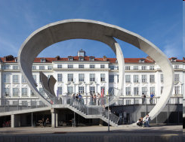
Master of Arts in Social Innovation
Danube University Krems, Austria
Department of Interactive Media and Technologies for Education – Centre of Interactive Media
Duration: 5 Semester, 120 ECTS, extra-occupational, blended learning
Next launch of study:
October 6th, 2014
Admission until end of 2014
Information:
www.donau-uni.ac.at/masi
4. Trends and examples …

Slide 25
www.donau-uni.ac.at
Master of Arts in Social Innovation
Modules providing competencies in science and practice
Scientific foundations in social science
Processes of societal transition
Economic dominance and change
Labour, employment and globalisation
Research project, writing the M.A. Thesis, approvement as certified ‚Social Innovator‘
Improving scientific skills
Distinct frames – equal levels
Research methodologies
Epistemology, science theory
Scientific writing & publishing
Communication, education and Technology Enhanced Learning
Innovation theory and overview of innovation research
Innovation systems
Measuring innovation
Theories & research concerning social innovation
Managing social innovation
in the public sector
in the private business sector
in the sector of civil society
Forms, dissemination and impact of social innovations in policy areas of interest (choice of subjects by students)
Technology, environment, climate change, resources, sustainability
4. Trends and examples …
Demographic change, living with migration and diversity
Core competencies acqu.:
To consult & monitor SI
To develop & implement SI
Fin. control & management
Evaluation and impact assessment of SI
Development and implementa-tion of social innovations
Generating ideas
Processing concepts
Realisation of social innovations
Inequality, health care and other social services
Department of Interactive Media and Technologies for Education, Centre of Interactive Media
Danube University Krems. The University of Continueing Education
Zentrum für Soziale Innovation

Slide 26

Tilburg Social Innovation Lab Netherlands
Who?
Four Universities from the area of Tilburg, founded 2011.
What?
Joining forces to make a visible contribution to the development of the region Brabant as the Region for Social Innovation.
A “do-tank” in which methods and innovations are generated.
How?
Involving regional stakeholders
Providing suitable interdisciplinary knowledge
4. Trends and examples …

Slide 27

Eutokia Social Innovation Center
Bilbao, Spain
Who?
Private-public collaboration, initiated by the Basque government, cooperation with different organisations and agents of the social innovation sector.
Founded 2010
What?
Supporting new ideas that have a social impact.
Facilitating creative space.
4. Trends and examples …
http://eutokia.org/

Slide 28
SOCIAL INNOVATION support
Social innovation and the EUROPE 2020 Strategy:
“…to design and implement programmes to promote social innovation for the most vulnerable, in particular by providing innovative education, training, and employment opportunities for deprived communities, to fight discrimination (e.g. disabled), and to develop a new agenda for migrants' integration to enable them to take full advantage of their potential…”
EU Programme for Employment and Social Innovation (EaSI):
proposed budget of € 815 million for 2014-2020
4. Trends and examples …
Overview of EU funded research projects under the „Social Sciences and Humanities“ programme in the 7th EU Framework for Research, Technology Development and Innovation:
http://ec.europa.eu/research/social-sciences/pdf/ssh-projects-fp7-5-6-social-innovation_en.pdf

Slide 29
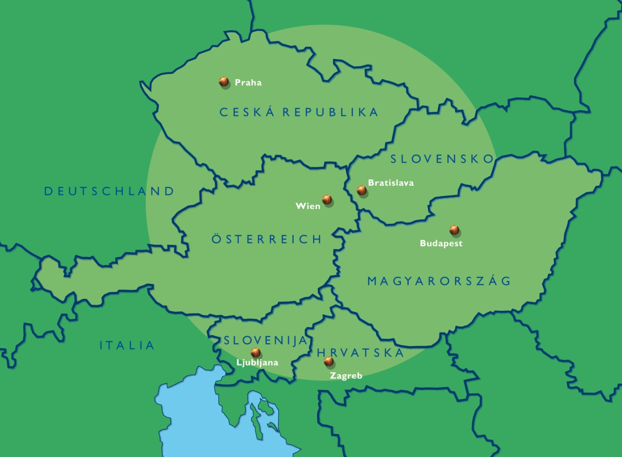
„SozialMarie“
The international Austrian award for successful social innovations
Eligible for submission are projects of the:
social economy (civil
society initiatives, NPOs/
NGOs, associations)
public sector,
administrations
private sector,
businesses
Applications since 2004: about 2500
1st prize: € 15,000
2nd prize: € 10,000
3rd prize: € 5,000
Total prize money awarded (to a number of now 135 awardees): € 420,000.--
4. Trends and examples …
www.sozialmarie.org
A different approach re. funding and stimulating ideas cf.
„The European Social Innovation Competition“ at http://socialinnovationcompetition.eu/

Slide 30
European Commission – DG Enterprise:
European Social Innovation Competition
“The Competition, launched in memory of Diogo Vasconcelos, invites Europeans to come up with new solutions to reduce unemployment and minimize its corrosive effects on the economy and our society both now and in the future. Social innovation is not only desirable, it is necessary.
It doesn’t matter if you haven’t found the right investor for your ideas yet. We can help you bring your project to life as part of our Social Innovation Academy.”
Three winning projects are awarded financial support of € 30,000
4. Trends and examples …
http://ec.europa.eu/enterprise/policies/innovation/policy/social-innovation/competition/contestants_en.htm

Slide 31
EIB – European Investment Bank:
Social Innovation Tournament
“The Social Innovation Tournament established by the EIB Institute in 2012 is the flagship initiative of its Social Program. The Tournament seeks to promote the generation of innovative ideas and reward opportunities promising substantial societal benefits or demonstrating best practices with tangible, scalable outcomes. It targets the creation of social value in relation to the fight against social exclusion. It thus covers projects in a wide range of fields, from education and health care to natural or urban environment, through new technologies, new systems, and new processes.”
4. Trends and examples …
http://institute.eib.org/programmes/social/social-innovation-tournament/

Slide 32
SOCIAL INNOVATION NETWORKING
Social Innovation Europe
https://webgate.ec.europa.eu/socialinnovationeurope/
SIE is building and streamlining the social innovation field in Europe.
The initiative is funded by the EC, DG Enterprise and Industry
SIX: Social Innovation eXchange
http://www.socialinnovationexchange.org
Over the last seven years, SIX has inspired, connected and supported thousands of individuals and organisations, across sectors and industries, to build the field of social innovation globally.
Identifying, connecting and building up SI Incubators:
http://www.benisi.eu/
BENISI will identify and scale up over 300 social innovations and will accelerate their scaling up.
http://transitionproject.eu/
Transnational Network for Social Innovation Incubation – TRANSITION – supports the scaling-up of social innovations across Europe by developing a network of incubators.
4. Trends and examples …

Slide 33
Various international and national activities:
Austria: Enquete to move SI forward? (Programmes and instruments in support of SI)
Croatia: Preparing a 40 mio. SI support programme 2014-2020 (advised by OECD);
SIL: http://www.socinnovationlab.org
Finland: The Funding Agency for Innovation addresses SI → www.tekes.fi/en/tekes
Germany: New Declaration «SI for Germany» → https://www.openpetition.de
New ideas competition ‘Land of ideas’: http://www.land-der-ideen.de/
NL: Declaration «Invest in SI», Kennisland & Waag Society
Sweden: Social Innovation in a Digital Context, Lund U., 60 ECTS www.luii.lu.se/education/sidc
Switzerland: National Fund for Research is drafting a SI research programme
4. Trends and examples …
Most current – here and now from Tilburg to Brussels:
Open Letter on social innovation to the new European Commission. Lobbying for social innovations and their importance from the local and regional levels up to the most important social innovation of the 21st century: Governance in favour of societal development beyond the Nation State, and Management of Abundance !

Slide 34
Thank you for your attention ☺
Prof. Dr. Josef Hochgerner
Centre for Social Innovation
Linke Wienzeile 246
A - 1150 Vienna
Tel. ++43.1.4950442
Fax. ++43.1.4950442-40
email: hochgerner@zsi.at
http://www.zsi.at

