Slide 1


National Innovation Conference and Exhibition
Nice 2014
Putra World Trade Centre – PWTC
Kuala Lumpur: Oct. 31st – Nov. 2nd, 2014
“SOCIAL INNOVATION ROCKS”
The concept of social innovation and
entry points to establish a Malaysian
social innovation policy
Josef Hochgerner
Zentrum für Soziale Innovation

Slide 2


Overview
Innovation culture in the industrial society: The prevailing paradigm of innovation and innovation systems
Extending the paradigm by introducing the concept of social innovation: Definition and the 4-i process
Permeation of social innovation in the knowledge society: Ideas, organisations and emerging infrastructures
Trends and examples of measures and support on European and national levels
Conclusions and recommendations

Slide 3
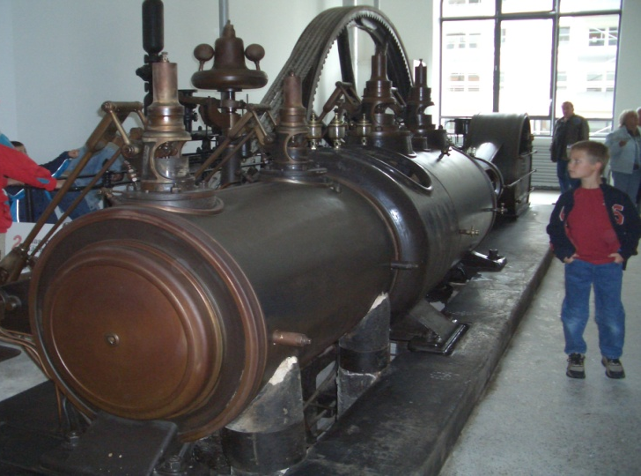
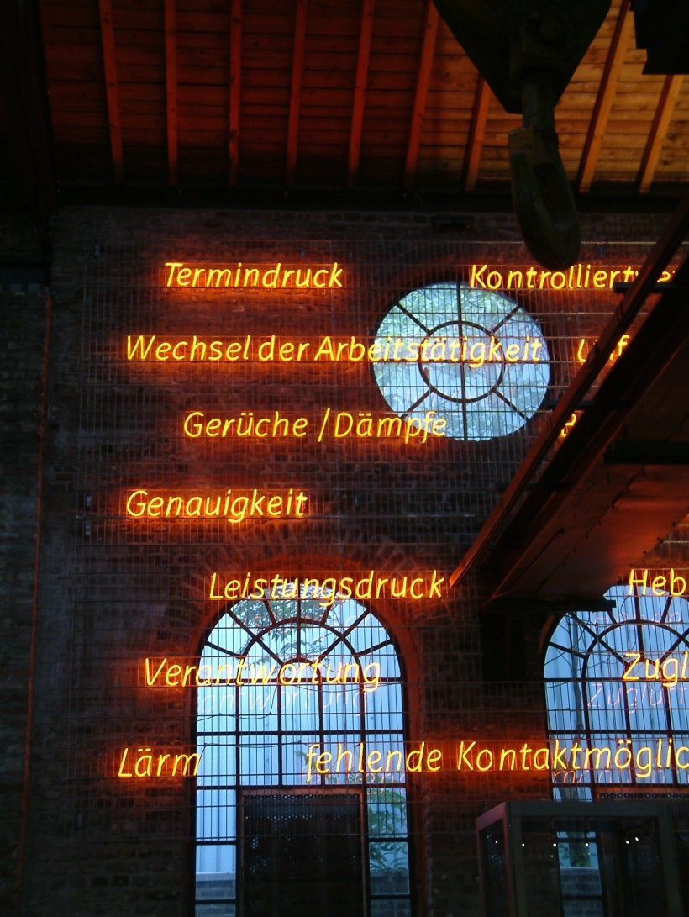

„ALL INNOVATIONS ARE SOCIALLY RELEVANT“
Innovations are embedded in social change
„Brave New World“:
Optimisation of human bevaiour in social systems – 20th century
The most famous steam engine -
Optimised by James watt, 1776
Standardisation
Weak ties in social relations: Flexibility
Acceleration, ‘speed kills‘
Pressures
Work-load
„Humans by Design“:
Optimisation in the 21st c.?
„Work-Life Balance“
1. Innovation culture …

Slide 4
SOCIAL INNOVATION BUILDS ON 100 YEARS OF INNOVATION THEORY
Comparison of the ‘new combinations’ according to Schumpeter with the ‘main types of innovations’ according to the Oslo Manual
“New combinations of production factors” # (SCHUMPETER 1911) | “Main types of innovations” in business (OECD 2005, ‘Oslo Manual’)
New or better products | Product innovations
New production methods | Process innovation
Opening up new markets | Marketing
Reorganization of the market position | Organizational innovations
New sources of raw materials
Major forms of social innovations
“New combinations of social practices”: social innovations, established in the form of …
Roles
Relations
Norms
Values

Slide 5


Society generates innovation
Innovations expand the range of human action ...
... and facilitate sometimes spectacular achievements:
The dominant innovation culture favours engineered changes by technology in societal sediments:
Technology made ‚skin‘ of society
The power structures in society
Modes of communication in society, between individuals, organisations, organisms and artifacts
Frames of reference, shaping manners, mores, myths & rites
The balance or imbalance of emotions in society (security / insecurity, hope / fear,
empathy / hatred … )
Earth rise from moon orbit, December 24, 1968
„Sputnik shock“ in the U.S. → and the vision thereafter
A walk in the sunshine,
July 21, 1969
Social innovations required as well !
Not one big innovation,
nor a series of innovations only!
→ result of a powerful socio-technical system,
enabled by a particular innovation culture

Slide 6



Social change, development, crisis and ‚Grand Challenges‘:
Resources and solutions
WHY SOCIAL INNOVATION ?
Evolution
of Brains
Innovative
Technologies
1. Innovation culture …
Social Innovation for Social Action !
Collaborative intelligence & intelligent collaboration
>> Cultural Evolution

Slide 7
The first world-wide conference on social innovation
research with 370 participants from 54 countries
around the globe. * Vienna, 19-21 Sep. 2011
“The tracks of international research on innovation demonstrate that the technology-oriented paradigm – shaped by the industrial society – does not cover the broad range of innovations indispensable in the transition from an industrial to a knowledge and services-based society: Such fundamental societal changes require the inclusion of social innovations in a paradigm shift of the innovation system.”
Cf. the “Vienna Declaration: The most relevant topics in social innovation research”, 2011, adopted by the conference CSI.
Information online: www.socialinnovation2011.eu
2. Extending the paradigm …

Slide 8
“THE GREAT TRANSFORMATION”
Karl Polanyi, 1944:
Economic processes separate from society, dominate
social relations instead of being regulated to benefit societal needs
Stress in social systems
Economy
Society
„Society becomes an
annex to the economy
and market forces.“
The utmost concern of social innovations in the 21st century:
To apply the vast economic potential
of the „knowledge society“,
as part of society, serving
distributive justice and
braking the acceleration
of social inequality.
2. Extending the paradigm …
Society
Environ-
ment
Economy

Slide 9
The termination of the ‚golden age of capitalism‘ *)
Wages remain static whilst productivity increases, USA 1959-2005
Stress in social systems
Index of productivity
1959 until 2005 (USA)
(1959=100)
Index of hourly compensation
of production workers and
non-supervisory workers
2. Extending the paradigm …
U.S. Data,
Source:
Economic Policy Institute
*) Eric Hobsbawm

Slide 10
The problem behind the challenges^{*)}
*) F.-J. Radermacher
“Financialisation“: Making money without real value added Depletion of productive economic resources
Stress in social systems
„Financialization“ is defined as a „pattern of accumulation in which profit making occurs increasingly through financial channels rather than through trade and commodity production“
Krippner, Greta R., 2004: ‘What is Financialization?’; mimeo, UCLA Department of Sociology, p. 14.
Cf. T. I. Palley, 2007: Financialisation. What it is and why it matters. www.levyinstitute.org/pubs/wp_525.pdf
The rise of social innovation in view of austerity measures and declining welfare: ‘Making more of less‘ ?
My personal favourite concerning the most needed social innovation of the 21st century:
„Management of abundance“ !

Slide 11
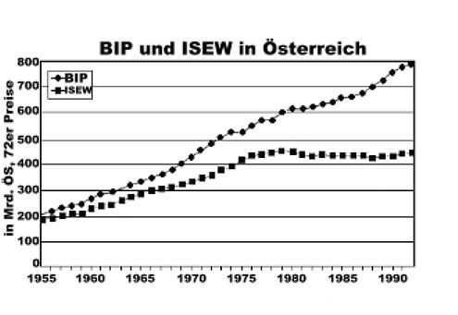
The termination of the ‚golden age of capitalism‘
Wealthier society provides less additional welfare
GDP (‚BIP‘) compared to ISEW (Index of Sustainable Economic Welfare)
in Austria, 1955 – 1992
Stress in social systems
2. Extending the paradigm …
Source: Stockhammer et al. 1995

Slide 12
An analytical definition of „Social Innovation“ *)
The CONCEPT OF SOCIAL INNOVATION
Distinction between idea and implementation: an idea becomes an innovation
in the process of its factual realization – it changes social action & practices
»Social innovations are new practices
for resolving societal challenges,
which are adopted and utilized by the individuals, social groups and organizations concerned.«
With reference to Schumpeter
(‚Innovations are new combinations of production factors‘)
→ »Social innovations are new
combinations of practices«
2. Extending the paradigm …
*) Zentrum für Soziale Innovation, 2012:
„All innovations are socially relevant“
ZSI-Discussion Paper 13, p. 2: www.zsi.at/dp

Slide 13
Areas relevant to social change | Examples of social innovations
 | Old / historic / previous | New / current / future
Science, education and training Work, employment and the economy Technologies, machinery Democracy, politics and justice Social and health care systems | Universities; compulsory education; Kindergarden; pedagog. concepts e.g. Montessori ... Trade unions; Chambers of commerce/labour; Taylorism; Fordism; self service Norms and standardisation; mechanisation of house keeping; traffic rules; drivers licence ‘Attic democracy’; the state as a juristic person; general elections Social security; retirement schemes, welfare state | Technology enhanced learning; ‘micro-learning’, Web 2.0; Wikipedia; ‘science mode 2’ Flextime wage records; CSR; social entrepreneurship; diversity mgmt.; collaborative consumption Open source movement (com-munities); self constructed solar panels; decentralized energy prod. Citizens participation; 3rd sector; equal rights; gender mainstreaming Reforms of financing and access to welfare (e.g. ‘birth right portfolio’)
2. Extending the paradigm …

Slide 14
IS innovation spectaCUlar by nature ?
Few innovations with basic and lasting impact, most innovations only improve what’s already functioning
Kind of
innovation
Technological innovation
Social innovation
Radical
innovation
Few / huge impact
e.g. Telephone
Few / huge impact
e.g. Democracy
Incremental
innovation
Many/cumulative impact
e.g. additional features
Many/cumulative impact
e.g. stakeholder involvement
2. Extending the paradigm …

Slide 15
HOW TO CREATE SOCIAL INNOVATION ?
The „4-i process“ of social innovation development:
  Idea >> What is the issue, what could be the solution?
  Intervention >> Conceptualisation, define approaches, methods
  Implementation >> Using resources, breaking deadlocks, cooperation
  Impact >> Measures of quality, range and scales, life cycle!
Ideation
Intervention
Implementation
Impact
2. Extending the paradigm …
Only if there is notable impact, according to the objective(s),
an idea becomes an innovation.
Success criteria: Novelty or superiority of the solution; involvement of and benefit to the target group(s); effectivenenss and sustainability; replicabilty and scaling.

Slide 16
Analysing social innovation examples
Public sector: Municipality of Kapfenberg (AT) – „Future for all“
  Idea >> Issue poverty – social assistance without stigmatisation
  Intervention >> „Activity Card“
  Implementation >> Transport companies, Caritas (NGO), Supermarket, Cafe, Sports ...
  Impact >> Participation, elevating quality of life and cohesion
Business sector: ERSTE Bank (AT) – „2nd Savings Bank“
  Idea >> Issue private persons excluded from finacial services, re-inclusion
  Intervention >> Collaboration with insolvency advisers and social care NGO
  Implementation >> Access to bank account, guidance by the NGO and bank volunteers
  Impact >> Learning, inclusions, empowerment, scaling
2. Extending the paradigm …
Civil society: Nagykaniza (HU) – „Social housing reconstruction camp“
  Idea >> Issue: social exclusion, threat of eviction from homes
  Intervention >> Negotiating rent arrears compensation by labour contributed
  Implementation >> Contracts, camp and co-ordination of students, roma, professionals
  Impact >> Better houses, cost/energy reduction, empowerment, replication

Slide 17
BUILDING SOCIAL INNOVATION SYSTEMS (1)
Extension of the innovation system and RTDI policies (Research, Technology Development and Innovation ― key requirements:
Incorporation of SI in universities, vocational training and adult education
Innovation in science (“Science Mode 2”, “Transformative Science”)
Funding of research on social innovation (focused programmes and accompanying research)
Development of indicators, metrics and statistics of social innovation
SI initiation and implementation in all sectors of society (private business, public administration, civil society organisations)
Networks and communication (magazines, platforms, various media)
Legal aspects of common goods, open innovation and IPR
3. Permeation into innovation systems

Slide 18
SOCIAL INNOVATION support
Social innovation and the EUROPE 2020 Strategy:
“…to design and implement programmes to promote social innovation for the most vulnerable, in particular by providing innovative education, training, and employment opportunities for deprived communities, to fight discrimination (e.g. disabled), and to develop a new agenda for migrants' integration to enable them to take full advantage of their potential…”
EU Programme for Employment and Social Innovation (EaSI):
budget € 815 million for 2014-2020
4. Trends and examples …
Overview of EU funded research projects under the „Social Sciences and Humanities“ programme in the 7th EU Framework for Research, Technology Development and Innovation:
http://ec.europa.eu/research/social-sciences/pdf/ssh-projects-fp7-5-6-social-innovation_en.pdf

Slide 19

3. Permeation into
innovation systems

Slide 20



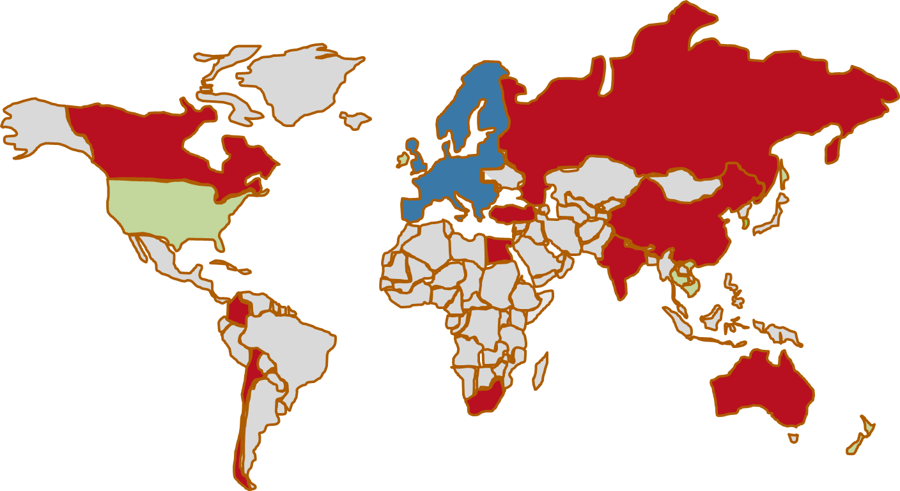














Social Innovation: Driving Force of Social Change
Research
International Consortium Members:
SI-DRIVE involves 15 partners from 12 EU Member States, 10 partners from other parts of the world, and 14 high level advisory board members: all in all 31 countries involved.
3. Permeation into innovation systems
blue: EU research partner, red: non-EU research partner,
green: Advisory Board
This project has received funding from the European Union’s 7th Framework Programme for research, technological development and demonstration under grant agreement no 612870.

Slide 21
CASES
Zentrum für Soziale Innovation * Centre for Social Innovation * Vienna
Working for social profit since 1990:
ZSI bridges
knowledge generation and
knowledge application
to reduce gaps between
social needs and technically
increased economic
capacities of the knowledge
society.
4. Trends and examples …

Slide 22

CASES
How we do it: The „RESEARCH – APPLICATION – SLALOM“
Knowledge implementation: Practices Knowledge generation: Research Knowledge diffusion: Education
Years
START: Identify a topic („knowledge gap“),
e.g. in 1994: „Ethnic Economies“
Coordination of networks
Research
Advisory services
Research
Education schools, univ.
„Ownership“
Research
Consulting
Public relations, PUS
2014 2006 2000 1994
„Ownership“
4. Trends and examples …
Education, vocational training
Consulting, networking
Research
„Ownership“
Research
Types of clients:
Public Authorities
Intermediaries
Foundations
Civil Soc./NGOs

Slide 23

Innovation in Public Administration
CASES
4-year FP7 project (2014-2017), coordinated by the ZSI
Supporting learning innovation in European Public Employment Services (PES)
Supporting PES in adapting to the changes to their world of work by facilitating professional identity transformation
First steps
Identify specific demands in CES to support appropriate competences development that address the need for integration and activation of job seekers in fast changing labour markets.
Establish links across PES in Europe to exchange experience and good practice
4. Trends and examples …
http://employid.eu

Slide 24

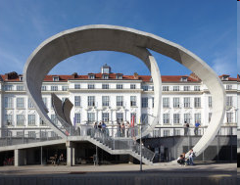
CASES
Master of Arts in Social Innovation
Danube University Krems, Austria
Department of Interactive Media and Technologies for Education – Centre of Interactive Media
Duration: 5 Semester, 120 ECTS, extra-occupational, blended learning
Launch of 2nd course of study:
October 6th, 2014
Admission until end of 2014
Information:
www.donau-uni.ac.at/masi
4. Trends and examples …

Slide 25
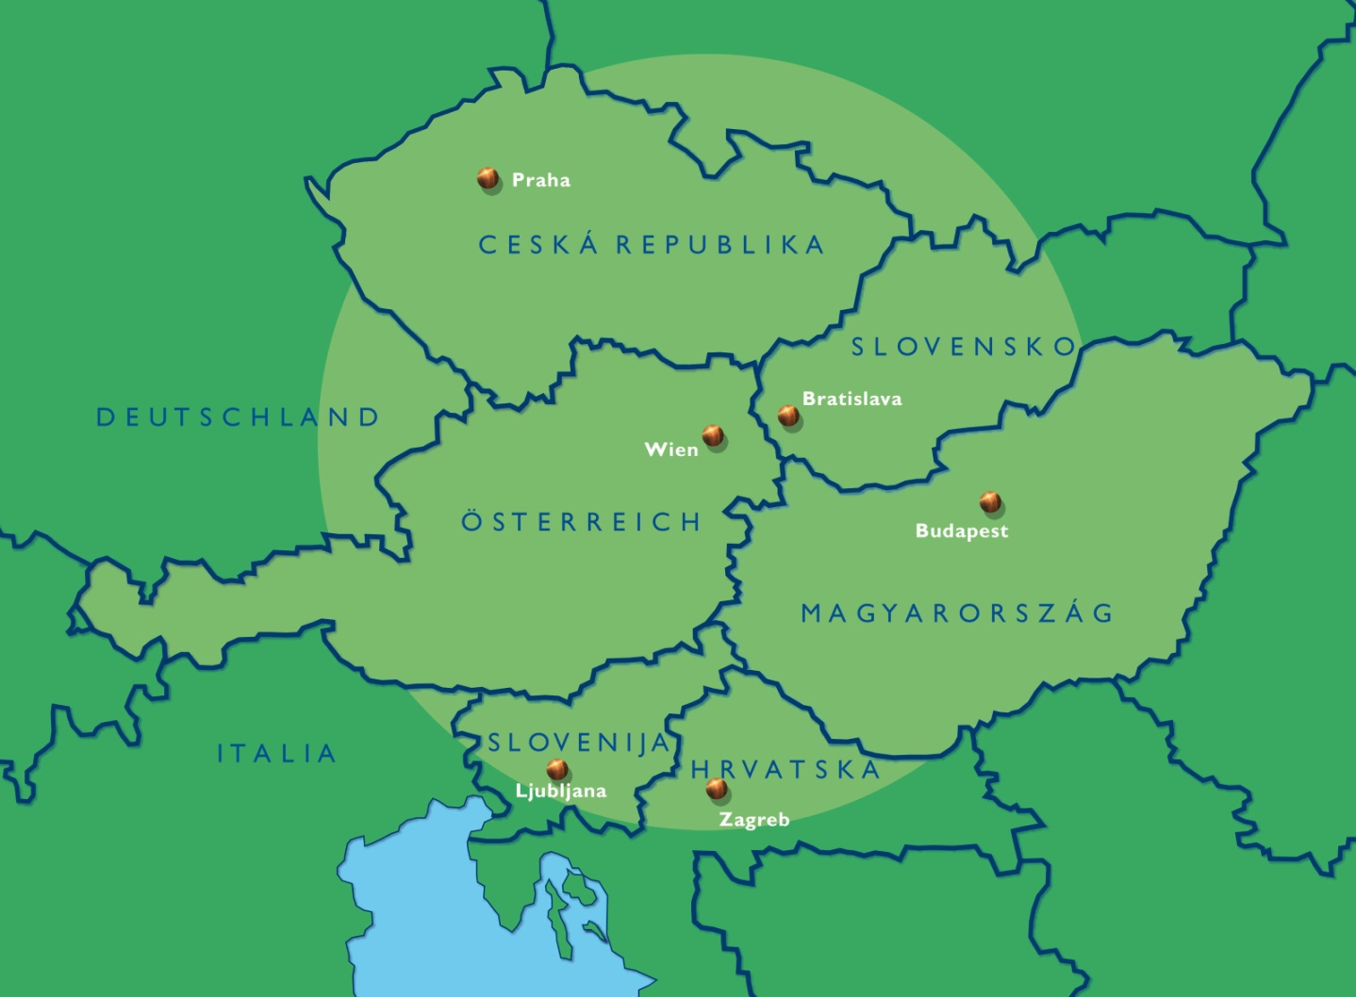
CASES
„SozialMarie“
The international Austrian award for successful social innovations
Eligible for submission are projects of the:
social economy (civil
society initiatives, NPOs/
NGOs, associations)
public sector,
administrations
private sector,
businesses
Applications since 2004: about 2500
1st prize: € 15,000
2nd prize: € 10,000
3rd prize: € 5,000
Total prize money awarded (to a number of now 135 awardees): € 420,000.--
4. Trends and examples …
www.sozialmarie.org
A different approach re. funding and stimulating ideas cf.
„The European Social Innovation Competition“ at http://socialinnovationcompetition.eu/

Slide 26
CASES
European Commission – DG Enterprise:
European Social Innovation Competition
“The Competition … invites Europeans to come up with new solutions to reduce unemployment and minimize its corrosive effects on the economy and our society both now and in the future. Social innovation is not only desirable, it is necessary.
It doesn’t matter if you haven’t found the right investor for your ideas yet. We can help you bring your project to life as part of our Social Innovation Academy.”
Three winning projects are awarded financial support of € 30,000
4. Trends and examples …
http://ec.europa.eu/enterprise/policies/innovation/policy/social-innovation/competition/contestants_en.htm

Slide 27
CASES
EIB – European Investment Bank:
Social Innovation Tournament
“The Social Innovation Tournament established by the EIB Institute in 2012 is the flagship initiative of its Social Program. The Tournament seeks to promote the generation of innovative ideas and reward opportunities promising substantial societal benefits or demonstrating best practices with tangible, scalable outcomes. It targets the creation of social value in relation to the fight against social exclusion. It thus covers projects in a wide range of fields, from education and health care to natural or urban environment, through new technologies, new systems, and new processes.”
4. Trends and examples …
http://institute.eib.org/programmes/social/social-innovation-tournament/

Slide 28

CASES
SINNERGIAK SOCIAL INNOVATION
(University of the Basque Country – Spain)
Does Action-Research in three fields:
Social Innovation, Creative Industries, and Innovation in the Public Sector
EUROPEAN PROJECTS: TRANSCREATIVA (leader), SIMPACT (partner), Creative Job (partner); OTHER PROJECTS: Ergolab (living lab), GIPUZKOA CREATIVA (creative industries), RESINDEX (social innovation indicators), Social Innovation Eco-Systems (Evaluation public policies), Gipuzkoa Workplace Innovation (regional public policies).
Provides education and training:
MA in Social Innovation and Creative Industries (University of the Basque Country)
Creative Poles: Competencies in solving social problems and creative industries
Social Innovation Summer Schools
4. Trends and examples …
Supports social innovation implementation through:
ERGOLAB: Innovation by users. HEDABIDE: Social Innovation Communities. TRANSCREATIVA: competencies and engagement unemployment young people

Slide 29

Social Innovation Laboratory (SIL)
Zagreb – Beograd – Skopje
CASES
Who?
Civil society organisations and networks from HR, SRB and MKD
Founded 2011
What?
Aims to improve quality of life in the Western Balkan Countries
Acts as platform for social innovations where knowledge, ideas and practices meet to find solutions for development challenges in the regional socio-economic context.
4. Trends and examples …
www.socinnovationlab.org/
“On national and local levels, we need partners and support not just in terms of funding but also recognition.”

Slide 30

Tilburg Social Innovation Lab Netherlands
CASES
Who?
Four Universities from the area of Tilburg, founded 2011.
What?
Joining forces to make a visible contribution to the development of the region Brabant as the Region for Social Innovation.
A “do-tank” in which methods and innovations are generated.
How?
Involving regional stakeholders
Providing suitable interdisciplinary knowledge
4. Trends and examples …

Slide 31
CASES
Scholarship for starters , i.e. unemployed youth https://www.startersbeurs.nu/ [“starter-bourse”]
A Social Innovation, developed by Tilburg University, NL, together with de City of Tilburg and Trade Unions.
Employers draw up a apprenticeship plan with the starter, the scholarship is for 6 months and can be prolonged at another employer for 6 months.
Scholarship funds are negotiated between the unions, the city and the public employment agencies.
Starters receive € 500 a month compensation and € 100 a month to save up for additional training.
The City (unemployment agencies) compensates the employers € 550 a month (counseling costs).
4. Trends and examples …

Slide 32
Key sources
Information about examples and funding policies:
Empowering people – driving change. Social innovation in the European Union.
Background study, leading the European Commission into the area of social innovation.
BEPA (Bureau of European Policy Advisers), 2010
http://ec.europa.eu/bepa/pdf/publications_pdf/social_innovation.pdf
THE OPEN BOOK OF SOCIAL INNOVATION.
Robin Murray, Julie Caulier-Grice, Geoff Mulgan, 2010
Presents a lot of cases from public, private and civil society sectors and information about various forms of support in …
the public sector
the grant economy
the market economy
the informal or household economy
http://youngfoundation.org/wp-content/uploads/2012/10/The-Open-Book-of-Social-Innovationg.pdf
GUIDE TO SOCIAL INNOVATION
European Commission, prepared by DG Regional and Urban Policy and DG Employment, Social affairs and Inclusion with inputs by various other DGs, 2013
Includes examples of social innovation funded by the Structural Funds and modes of funding
http://ec.europa.eu/regional_policy/sources/docgener/presenta/social_innovation/social_innovation_2013.pdf
4. Trends and examples …

Slide 33
The SWOT table of Malaysia (1) [OECD 2013]
Innovation in South-East Asia – Country Report Malaysia: pp. 181-222 http://www.keepeek.com/Digital-Asset-Management/oecd/science-and-technology/innovation-in-southeast-asia-2012_9789264128712-en#page212.
Strengths | Weaknesses
Large presence of MNE in electronics automotive sectors Research capabilities High competitiveness ranking Young population Natural resource endowments Economic and political stability Islamic leadership credentials Coherent vision for the country Substantial investments in tel-co infrastructure | Poor quality education and skills Declining private investment and low productivity growth Stagnant R&D and innovative capacity Low absorptive capacity of SMEs, little technology transfer & spillovers Few industry links to public research Little entrepreneurship & venture capital Unco-ordinated national S&T policy weak implementation of strategies
5. Conclusions and recommendations

Slide 34
The SWOT table of Malaysia (2) … continued
Opportunities | Threats
Increasing focus on high-technology exports to developed economies International reputation as centre for Islamic banking and finance Burgeoning service sector including expansion of tourism industry Sizeable Malaysian diaspora Diversification of trade and production towards more knowledge-intensive goods/services Increasing engagement of SMEs in more innovation driven strategies | Impacts of regional and global economic downturns Increasing competition from other Asian economies for trade and foreign investment Increasing brain drain Racial polarisation and religious extremism
5. Conclusions and recommendations

Slide 35
Critical social issues to be addressed
SWOT sections | Issues
Strengths | Young population Economic and political stability Islamic leadership credentials Coherent vision for the country
Weaknesses | Poor quality education and skills Unco-ordinated national S&T policy weak implementation of strategies
Opportunities | International reputation as centre for islamic banking and finance Burgeoning service sector including expansion of tourism industry Sizeable Malaysian diaspora
Threats | Increasing brain drain Racial polarisation and religious extremism
… by policies for social innovation development and implementation
❶
❷
❸

Slide 36
Three clusters to select potential social innovation priorities:
❶ Young population – Poor quality education and skills – Increasing brain drain – Malaysian diaspora
Fields of action to be addressed by social innovations:
Education and training of the young generation
Return programmes for educated and skilled Malaysians in diaspora
❷ Economic and political stability – Islamic leadership credentials – International reputation as centre for Islamic banking and finance – Racial polarisation and religious extremism
Provision of equal opportunities and participation in politics, culture and economic prosperity
Turning racial diversity and islamic challenges into opportunities
❸ Coherent vision for the country – Uncoordinated national S&T policy, weak implemen-tation of strategies – Burgeoning service sector including expansion of tourism industry
Communication/involvement creating „ownership“ of the vision to become a high income country
Service sector development and tourism embedded components of the vision
Science, technology and innovation policies should be geared towards improvement of quality of life, not merely economic growth
5. Conclusions and recommendations

Slide 37
Policies and instruments
Areas of SI / social innovation activities | Policies, objectives | Resources and instruments
SI Science and Research | Thematic priorities Accompanying research concerning TD&Innovation Methods and metrics: SI process analysis, impact measurement | Key topics research programme („transformative research“) Inclusion of social dimensions and impact research on RTDI programs Design, trials and use of indicators, capacities for evaluation/monitoring international comparison (‚manual‘)
SI infrastructures | Education and training Statistics | SI in vocational training, polytechn. Schools, universities, post-grad. ed. National/regional/sectoral stats.
SI implementation | Initiation, start-up support From idea to impact Encouragement/ acknow-ledgement of success | Incubators (SI Hubs) Grants, preferential loans, tax credits Awards, honours, communication and debates in media, publicity
5. Conclusions and recommendations

Slide 38
Thank you for your attention ☺
Prof. Dr. Josef Hochgerner
Centre for Social Innovation
Linke Wienzeile 246
A - 1150 Vienna
Tel. ++43.1.4950442
Fax. ++43.1.4950442-40
email: hochgerner@zsi.at
http://www.zsi.at

